Slide 1
1.6.8.8 Integer powers of complex numbers

Slide 2
Introduction
In this topic, we will
Define integer powers of a complex number
Derive a formula from the polar representation
Look at a geometric interpretation
Observe some properties

Slide 3
Integer exponents
Given , then for an integer n, we define
For example, (1.6 + 1.2j)^{–10} would be calculated by using
(0.4 – 0.3j) ¹⁰
Note that 0⁰ = 1, 0^{n} = 0 if n > 0, and 0^{n} is not defined if n < 0

Slide 4
Polar representation
Now, if , observe that

Slide 5
Polar representation
Similarly, if , so

Slide 6
Polar representation
This suggests for all integer values of n
We could even use this to define
for any real α
In this course, we will restrict ourselves to polynomials that require integer exponents

Slide 7
Complex division
As an example:

Slide 8
Complex division
As an example: so

Slide 9
Complex division
Note that z^{n} and z^{–n} are multiplicative inverses of each other:

Slide 10
Proof of formula
Theorem:
Proof: When n = 0,
Assume the formula is correct for an arbitrary n ≥ 0, that is, .
Then,
Thus, by the process of mathematical induction, the statement is true for all n = 0, 1, 2, 3, … .

Slide 11
Proof of formula
Theorem:
Proof: When –n < 0, the polar representation is unchanged:
The formula, however, says for – n < 0 that
Thus, the formula is correct for all n.
QED

Slide 12
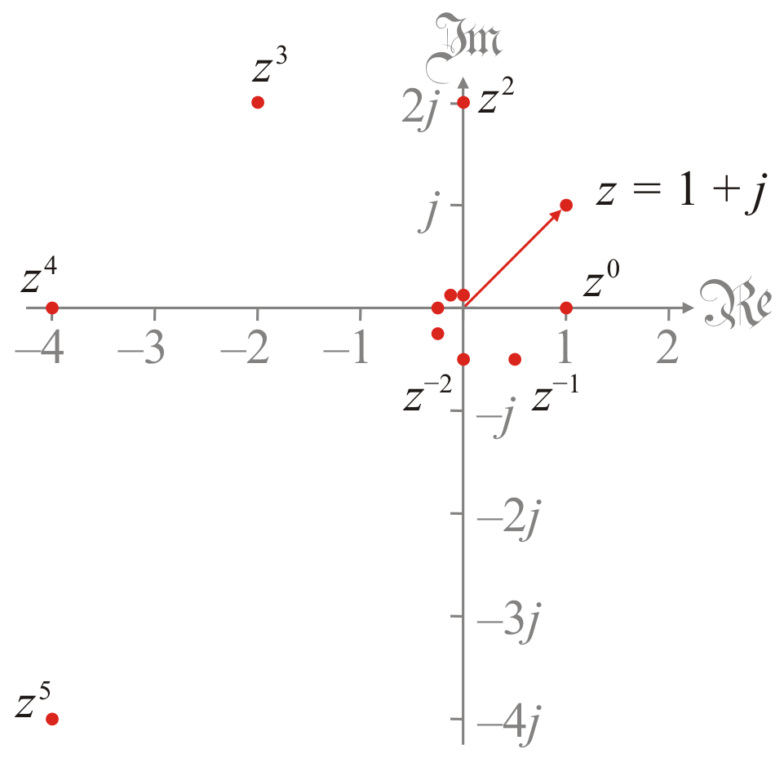
Geometric interpretation
The geometric interpretation of integer powers is a spiral
Powers of z = 1 + j
This is a logarithmic spiral

Slide 13
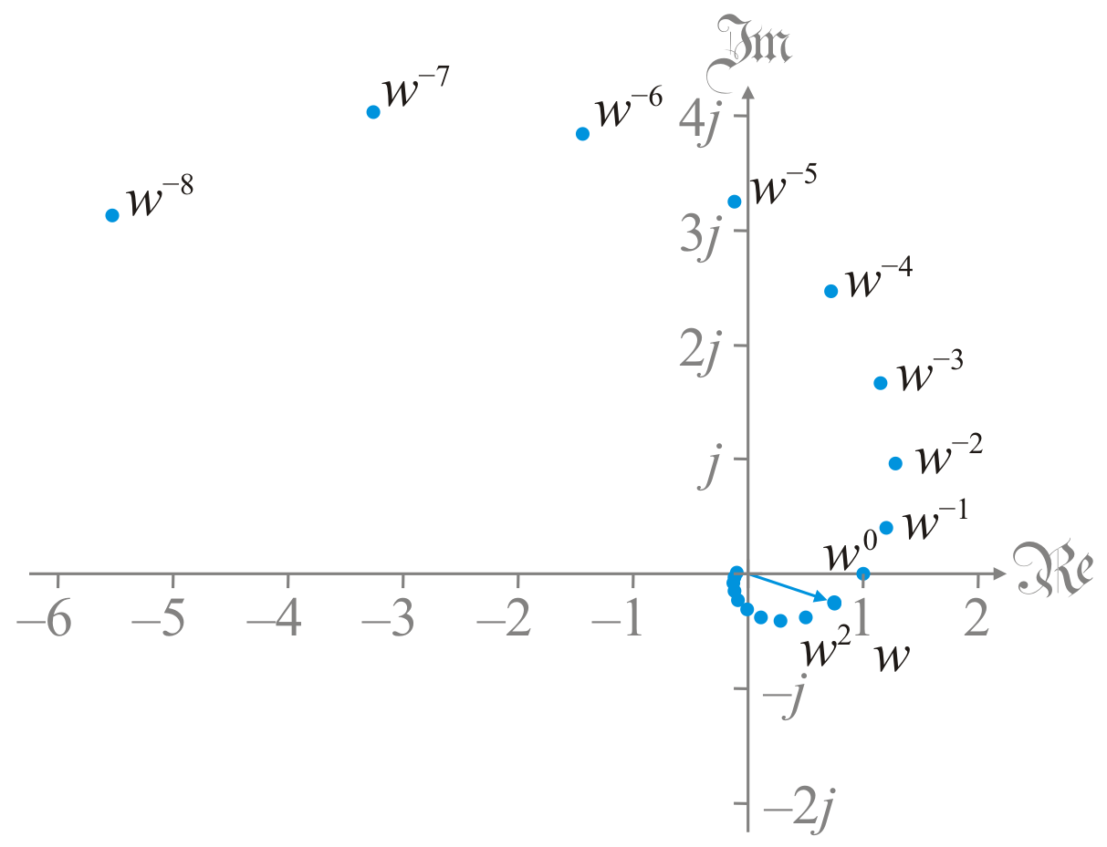
Geometric interpretation
The geometric interpretation of integer powers is a spiral
Powers of w = 0.75 – 0.25j where w^{–1} = 1.2 + 0.4j

Slide 14
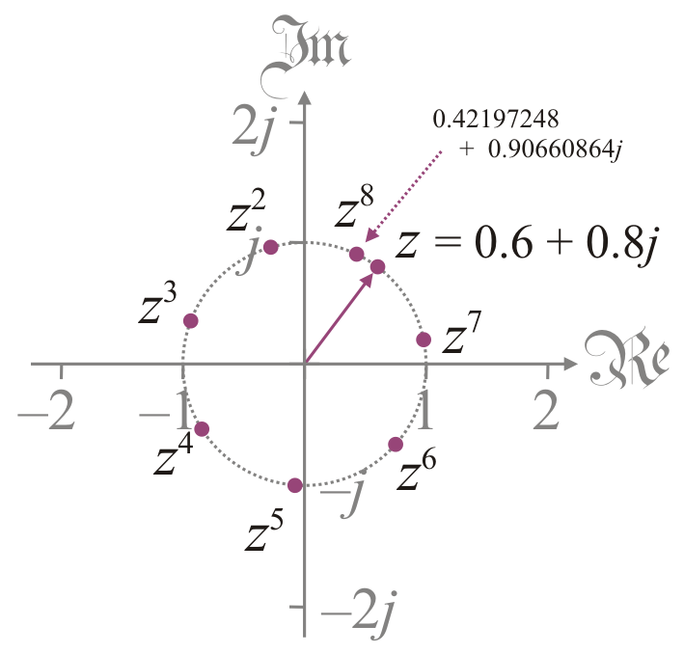
Geometric interpretation
The geometric interpretation of integer powers is a spiral
If |z| = 1, then all powers remain on the unit circle
Here z = 0.6 + 0.8j

Slide 15
Properties
Theorem:
Proof: Obvious from the polar representation.
QED

Slide 16
Properties
Theorem: If z = α + 0j is a positive real number then z^{n} = α ^{n}.
Proof: If z = α + 0j where α > 0, then |z| = |α| = α, so ,
QED

Slide 17
Properties
Theorem: If z = –α + 0j is a negative real number then z^{n} = (–α) ^{n}.
Proof: If z = –α + 0j where α > 0, then |z| = |α| = α , so ,
QED

Slide 18
Properties
Theorem:
Proof: This is also straight-forward:
QED

Slide 19
Summary
In this topic, we’ve introduced integer powers of complex numbers
We used the same definition as for integer powers of real numbers
We derived the polar representation
We saw the geometric interpretation
Rather beautiful spirals
We saw a number of properties

Slide 20
References
[1] https://en.wikipedia.org/wiki/Complex_number#Exponentiation
[2] https://en.wikipedia.org/wiki/Logarithmic_spiral

Slide 21
Acknowledgments
None so far.

Slide 22
Colophon
These slides were prepared using the Cambria typeface. Mathematical equations use Times New Roman, and source code is presented using Consolas.
The photographs of flowers and a monarch butter appearing on the title slide and accenting the top of each other slide were taken at the Royal Botanical Gardens in October of 2017 by Douglas Wilhelm Harder. Please see
https://www.rbg.ca/
for more information.

Slide 23
Disclaimer
These slides are provided for the ne 112 Linear algebra for nanotechnology engineering course taught at the University of Waterloo. The material in it reflects the authors’ best judgment in light of the information available to them at the time of preparation. Any reliance on these course slides by any party for any other purpose are the responsibility of such parties. The authors accept no responsibility for damages, if any, suffered by any party as a result of decisions made or actions based on these course slides for any other purpose than that for which it was intended.

